Slide 1
Introduction to Fluid Mechanics
and
Fluid Properties

Slide 2
Introduction
Fluid mechanics is a branch of physics concerned with the mechanics of fluids (liquids, gases and plasmas) and the forces acting on them.
Fluid mechanics has a wide range of applications:
Mechanical Engineering
Civil Engineering
Chemical Engineering
Geophysics
Astrophysics
Biology

Slide 3
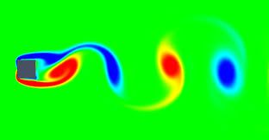
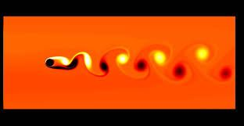

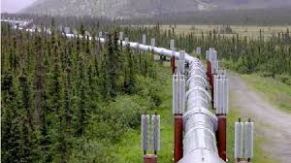
Applications
Flow past a square cylinder
Flow past a circular cylinder
Flow past an airfoil
Flow through a pipe

Slide 4
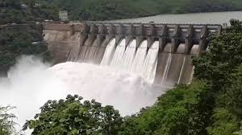
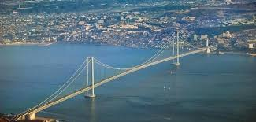
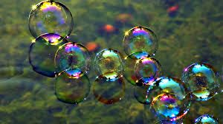
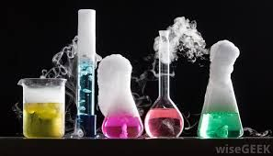
Applications
Flow through syphon
Flow past a suspension bridge
Bursting of bubbles
Chemical reaction

Slide 5
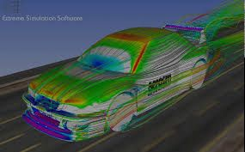
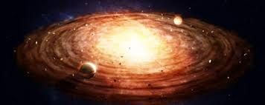
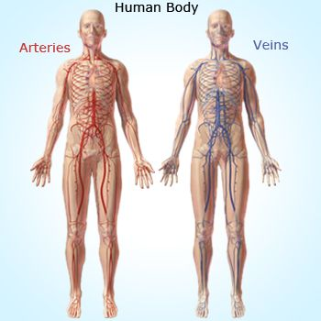

Applications
Flow past a motor car
Astrophysics
Blood flow inside veins and arteries
Water flow in a plant

Slide 6


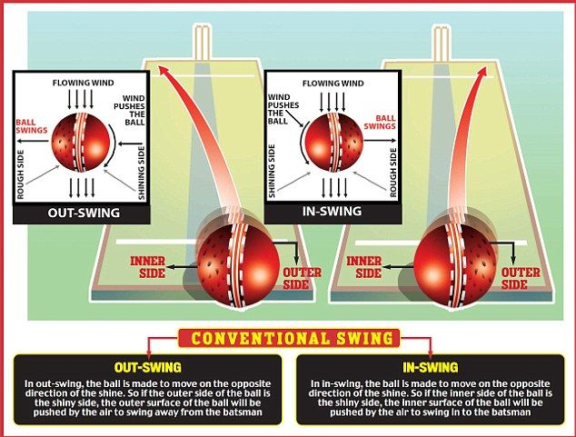
Applications
Flying of Birds
Denting of golf ball
Bowling of cricket ball

Slide 7
Reference Books
Fluid Mechanics and Fluid Power Engineering by D.S. Kumar, S.K.Kataria &
Sons
2. Fluid Mechanics and Hydraulic Machines by R.K. Bansal, Laxmi Publications
3. Fluid Mechanics and Hydraulic Machines by R.K. Rajput, S.Chand & Co.
4. Fluid Mechanics by Frank .M. White, McGraw Hill Publishing Company Ltd.
5. Fundamentals of Fluid Mechanics by Munson, Wiley India Pvt. Ltd
6. Fluid Mechanics by A. K. Mohanty, PHI Learning Pvt. Ltd.
7. Laboratory Manual Hydraulics and Hydraulic Machines by R V Raikar

Slide 8
Course Outcome
Students should be able to:
Understand the basic concept of fluid mechanics.
Understand statics, dynamics and various approaches to fluid mechanics.
Understand fundamentals of flow through pipes
Understand basics of compressible flow
Correlate fundamentals of fluid mechanics with various mechanical systems

Slide 9
Fluid Mechanics
Fluid Statics
Fluid Kinematics
Fluid Dynamics
study of fluids at rest
study of fluids in motion without considering the forces acting on the system
study of fluids in motion with effect of forces acting on the system
Fluid mechanics is a branch of continuum mechanics.
Continuum mechanics models matter from a macroscopic viewpoint rather than from microscopic.

Slide 10
Fluid Continuum
The concept of continuum assumes a continuous distribution of mass within the matter or system with no empty space, instead of the actual conglomeration of separate molecules.
In continuum approach, fluid properties such as density, viscosity, thermal conductivity, temp, etc can be expressed as functions of space and time.
The space factor is the distance between the molecules which is a function of molecular density.
The distance between the molecules is characterized by mean free path which is a statistical average distance the molecules travel between two successive collisions

Slide 11
Fluid Continuum
Say, = mean free path
L = Characteristic Length
If , fluid is considered as continuous medium
(Molecular density is very high)
If , fluid cannot be considered as continuous medium
(Fluid system is analyzed by molecular theory)

Slide 12
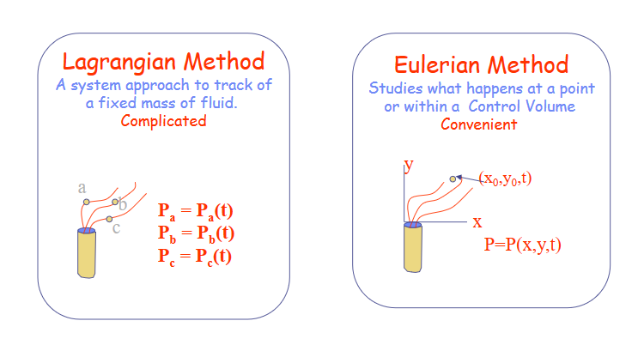
Methods of Describing Fluid Motion

Slide 13

Methods of Describing Fluid Motion
Lagrangian vs Eulerian approach

Slide 14
Fluid Vs. Solid
τ
A fluid is a substance that deforms continuously when subjected to a tangential or shear stress
α
α
But the molecules of a solid are closely packed as compared to that of a fluid. Attractive forces between the molecules of a solid are much larger than those of a fluid.
Solids can resist tangential stress under static conditions
When this tangential stress disappears, solids regain either fully or partially their original shape, where as a fluid can never regain its original shape.

Slide 15
Properties of Fluids
Any characteristic of a system is called a property.
Familiar: pressure P, temperature T, volume V, and mass m.
Less familiar: viscosity, thermal conductivity, modulus of elasticity, thermal expansion coefficient, vapor pressure, surface tension.
Intensive properties are independent of the mass of the system. Examples: temperature, pressure, and density.
Extensive properties are those whose value depends on the size of the system. Examples: Total mass, total volume, and total momentum.
Extensive properties per unit mass are called specific properties. Examples include specific volume v = V/m and specific total energy e=E/m.

Slide 16
Properties of Fluids
Density (ρ): mass per unit volume. (It decreases with increase in temperature)
(units: kg/m³)
2. Specific Weight (ϒ): weight per unit volume. (It refers to the heaviness of the fluid)
(units: N/m³)
3. Specific Volume (υ): volume occupied by unit mass of fluid
(units: m³ /kg)

Slide 17
Properties of Fluids
4. Specific Gravity (s):
For Liquids; it is the ratio of density of liquid at actual conditions to density of water at 101 kN/m² and at 4 ⁰C
For gases; it is the ratio of density of a particular gas at actual conditions to density of either hydrogen or air at some specified temperature or pressure.
Conditions must be stated while referring to specific gravity of gases.

Slide 18
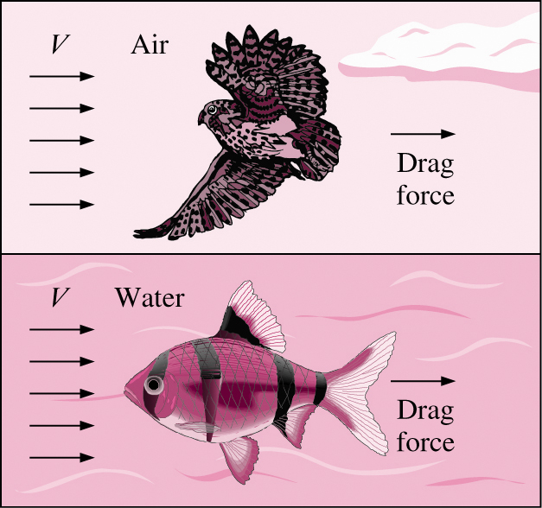
5. Viscosity
Properties of Fluids
Viscosity is a property that represents the internal resistance of a fluid to motion.
The force a flowing fluid exerts on a body in the flow direction is called the drag force, and the magnitude of this force depends, in part, on viscosity.

Slide 19
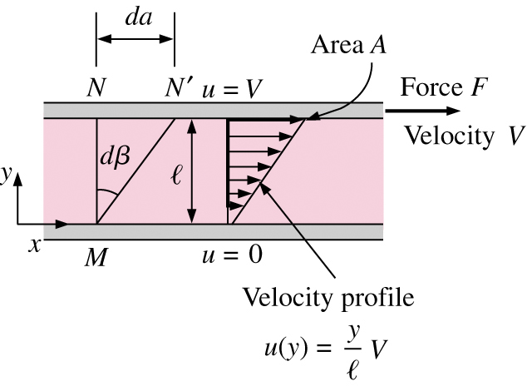
Viscosity
To obtain a relation for viscosity, consider a fluid layer between two very large parallel plates separated by a distance ℓ
Definition of shear stress is τ = F/A.
Using the no-slip condition, u(0) = 0 and u(ℓ) = V, the velocity profile and gradient are u(y)= Vy/ℓ and du/dy=V/ℓ
Shear stress for Newtonian fluid:
(Newton’s Law of Viscosity)
μ is the dynamic viscosity and has units of kg/m·s, Pa·s, or poise.

Slide 20
Causes of Viscosity
Intermolecular force of cohesion
Exchange of molecular momentum
Due to strong cohesive forces between the molecules, any layer in a moving fluid tries to drag the adjacent layer to move with an equal speed and thus produces the effect of viscosity.
The individual molecules of a fluid are continuously in motion and this motion makes a possible process of an exchange of momentum between different moving layers of this fluid.
Although the process of molecular momentum exchange occurs in liquids, intermolecular cohesion is the predominant cause of viscosity in a liquid. Since, cohesion decreases with temperature, the liquid viscosity does likewise.
In gases, the intermolecular cohesive forces are very small and the viscosity is dictated by molecular momentum exchange. As the random molecular motion increases with a rise in temperature, the viscosity also increases accordingly.

Slide 21
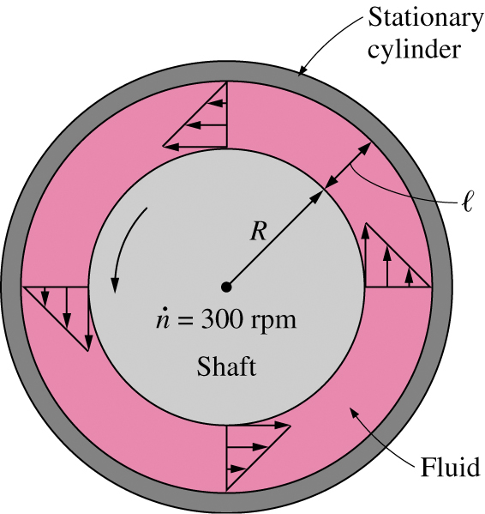
Viscometry
How is viscosity measured?
A rotating viscometer:
Two concentric cylinders with a fluid in the small gap ℓ.
Inner cylinder is rotating, outer one is fixed.
As per definition of shear force:
If ℓ/R << 1, then cylinders can be modeled as flat plates.
Torque T = FR, and tangential velocity V= ωR
Wetted surface area A=2πRL.
Measure T and ω to compute μ.

Slide 22
Problem # 1
A cylinder of 150 mm radius rotates concentrically inside a fixed cylinder of 155 mm radius. Both cylinders are 300 mm long. Determine the viscosity of the liquid which fills the space between the cylinders if a torque of 0.98 N-m is required to maintain an angular velocity of 60 RPM.
(Ans: 0.123 Ns/m²)
Problem # 2
A piston of 796 mm diameter and 200 mm long works in a cylinder of 800 mm diameter. If the annular space is filled with a lubricating oil of viscosity 5 cP, calculate the speed of descent of piston in vertical position. The weight of the piston and the axial load are 9.8 N.
(Ans: 7.841 m/s)

Slide 23
Problem # 3
A space of 25 mm wide between two large plane surfaces is filled with glycerine. What force is required to drag a very thin plate 0.75 m² in area between the surfaces at a speed of 0.5 m/s
If this plate remains equidistant from the two surfaces
If it is at a distance of 10 mm from one of the surfaces.
Consider μ = 0.785 N-s/m^{2.}
Ans: (i) 47 N (ii) 49 N

Slide 24
Ideal Fluids
Hypothetical fluid having zero viscosity
Resulting motion is called ideal or inviscid flow.
In ideal flow there is no existance of shear force.
All the fluids in reality have viscosity (μ > 0) and hence they are termed as real fluid and their motion is known as viscous flow.
Under certain situations of very high velocity flow of viscous fluids, an accurate analysis of flow field away from a solid surface can be made from the ideal flow theory.

Slide 25
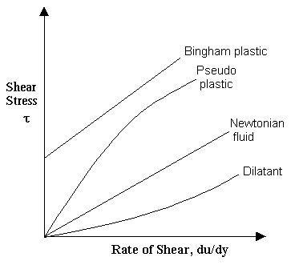
Non-Newtonian Fluids
‘m’ : flow consistency index
‘n’ : flow behavior index.
For n = 1 → Newtonian fluid
n < 1 → Pseudo-plastic fluids such as gelatin, blood, milk, etc.
n > 1 → Dilatant fluids such as sugar in water, rice starch, etc.

Slide 26
Problem # 4
In an experiment, the following shear stress - time rate of shear strain values are obtained for a fluid:
Time rate of shear strain (1/s): 0 2 3 4
Shear stress (kPa) : 0 1.4 2.6 4
(a) Newtonian fluid (b) Bingham plastic
(c) Pseudo plastic (d) Dilatant

Slide 27
Properties of Fluids
6. Kinematic Viscosity (ν)
(m² /s)
[L² T⁻¹ ]
The importance of kinematic viscosity in practice is realized due to the fact that while the viscous force on a fluid element is proportional to μ, the inertia force is proportional to ρ and this ratio of μ and ρ appears in several dimensionless similarity parameters like Reynolds number ( ), Prandtl number ( ), etc. in describing various physical problems.

Slide 28
Properties of Fluids
7. Compressibility
Compressibility of any substance is the measure of its change in volume under the action of external forces (namely, the normal compressive forces)
The normal compressive stress on any fluid element at rest is known as hydrostatic pressure P and arises as a result of innumerable molecular collisions in the entire field.
The degree of compressibility of a substance is characterized by the bulk modulus of elasticity (E).

Slide 29
Compressibility
For a given mass of a substance, the change in its volume and density satisfies the relation :
Therefore, Compressibility can be expressed as:
Values of E for liquids are very high as compared with those of gases (Except at very high pressure). Therefore, liquids are usually termed as incompressible fluids though, in fact, no substance is theoretically incompressible with a value of E as infinity.

Slide 30
Compressibility
For gases another characteristic parameter, known as compressibility K, is usually defined , it is the reciprocal of E:
For any gaseous substance, a change in pressure is generally associated with a change in volume and a change in temperature simultaneously.
A functional relationship between the pressure, volume and temperature at any equilibrium state is known as thermodynamic equation of state for the gas.

Slide 31
Problem # 5
When the pressure on a given mass of liquid is increased from 3.0 MPa to 3.5 MPa, the density of the liquid increases from 500 kg/m³ to 501 kg/m³. What is the average value of bulk modulus of the liquid over the given pressure range?
(a) 700 MPa (b) 600MPa
(c) 500MPa (d) 250MPa

Slide 32
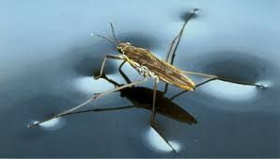
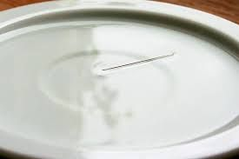

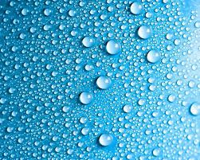
Properties of Fluids
8. Surface Tension
Walking on Water
Floating a Needle
Washing of Clothes
Spherical Water Bubbles

Slide 33
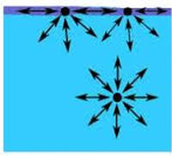
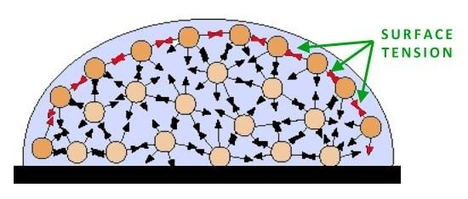
Surface Tension
A molecule in the bulk liquid experiences cohesive forces with other molecules in all directions.
A molecule at the surface of a liquid experiences only net inward cohesive forces.
The surface tension of a liquid results from an imbalance of intermolecular attractive forces, the cohesive forces between molecules.
Surface tension is measured as the energy required to increase the surface area of a liquid by a unit of area.

Slide 34
Surface Tension
If an imaginary line is drawn on the surface, the liquid molecules on both sides will pull the linear element in both the directions and this line will be subjected to a state of tensile force.
The magnitude of surface tension is defined as the tensile force acting across such short and straight elemental line divided by the length of the line.
Surface tension decreases slightly with increase in temperature. Surface tension of water at 20 ⁰C is 0.073 N/m.
The dimensional formula is:
F/L or MT⁻² (Unit: N/m)
It is due to surface tension, that a liquid interface curved and in equilibrium results in a greater pressure at the concave side of the surface than at its convex side.

Slide 35
Surface Tension
For a spherical liquid drop:
For cylindrical liquid jet:
For a spherical bubble:

Slide 36
Problem # 6
If the surface tension of water-air interface is 0.073 N/m, the gauge pressure inside a rain drop of 1 mm diameter will be:
(a) 0.146N/m² (b) 73N/m²
(c) 146N/m² (d) 292 N/m²
Problem # 7
What is the pressure inside a soap bubble, over the atmospheric pressure if its diameter is 2 cm and the surface tension is 0·1 N/m?
(a) 0·4 N/m² (b) 4·0 N/m²
(c) 40.0 N/m² (d) 400.0 N/m²

Slide 37
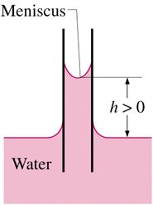
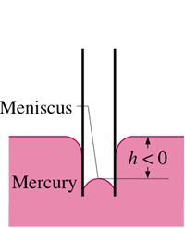
Properties of Fluids
9. Capillarity
Capillary effect is the rise or fall of a liquid in a small-diameter tube.
The curved free surface in the tube is called the meniscus.
Water meniscus curves up because water is a wetting fluid.
Mercury meniscus curves down because mercury is a nonwetting fluid.

Slide 38
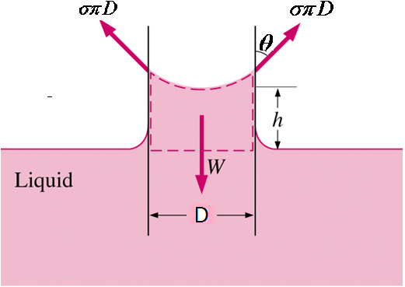
Capillarity
Equating the weight of the column of liquid ‘h’ with the vertical component of the surface tension force:
For pure water in contact with air in a glass tube, the capillary rise takes place with ϴ = 0⁰.
Mercury causes capillary depression with an angle of contact of about 130⁰ in a clean glass in contact with air.

Slide 39
Problem # 8
What is the approximate capillary rise of water in contact with air (surface tension 0.073 N/m) in a clean glass tube of 5mm in diameter?
^{Ans: 5.95}

Slide 40
Properties of Fluids
10. Vapor Pressure
All liquid have a tendency to evaporate when exposed to a gaseous atmosphere. The rate of evaporation depends upon the molecular energy of the liquid which in turn depends upon the type of liquid and its temperature. The vapor molecules exert a partial pressure in the space above the liquid, known as vapor pressure.
If the space above the liquid is confined and the liquid is maintained at constant temperature, after sufficient time, the confined space above the liquid will contain the vapor molecules to the extent that some of them will be forced to enter the liquid.
Eventually, an equilibrium condition will evolve when the rate at which the number of vapor molecules striking back the liquid surface and condensing is just equal to the rate at which they have evaporated from the surface. The space above the liquid then becomes saturated with vapor.

Slide 41
Vapor Pressure
Factors influencing the rate of evaporation:
Concentration of the evaporating substance in the air ( ↓ , slowly )
Concentration of other substances in the air (↓ , slowly )
Concentration of other substances in the liquid ( ↓ )
Flow rate of air ( ↑ )
Inter-molecular forces (↓ )
Density ( ↓ )
Surface area ( ↑ )
Pressure ( ↑ )
Temperature of the substances ( ↑ )

Slide 42
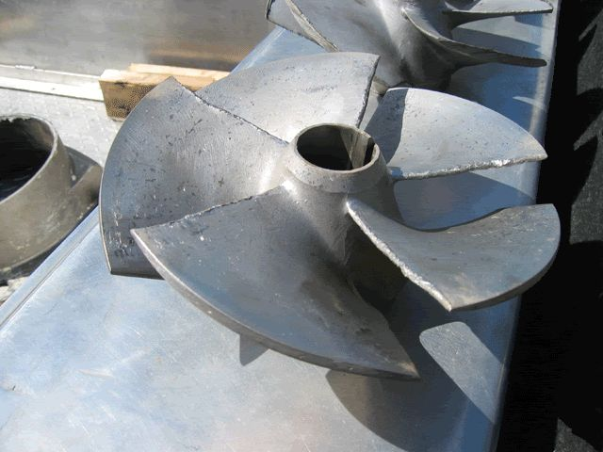
Vapor Pressure and Cavitation
Vapor Pressure P_{v} is defined as the pressure exerted by its vapor in phase equilibrium with its liquid at a given temperature
If P drops below P_{v}, liquid is locally vaporized, creating cavities of vapor.
Vapor cavities collapse when local P rises above P_{v}.
Collapse of cavities is a violent process which can damage machinery.
Cavitation is noisy, and can cause structural vibrations.

Slide 43
Ideal Fluids vs Real Fluids
Ideal Fluids
Real Fluids
Incompressible
It has zero viscosity
No resistance is encountered as the fluid moves
Compressible
Viscous in nature
Certain amount of resistance is always offered by these fluids as they move

Slide 44
Incompressible vs Compressible Flow
Incompressible Flow
Compressible Flow
Constant density (Usually liquids) (even though they are very slightly compressible in the real world, this is negligible from an educational standpoint)
Variable density (Usually gases)
Mach number (which is the ratio of the speed of the flow to the speed of sound at a particular temperature) is less than 0.3
Mach number is greater than 0.3

